Slide 1
Data Structures
ICT-1211
Information and Communication Technology
Lecture-13
Date: //2024

Slide 2
Linked Lists

Slide 3
LINKED LISTS: Inserting at the Beginning ….ALG
INSFIRST (INFO, LINK, START, AVAIL,ITEM)
[OVERFLOW?] If AVAIL=NULL, then Write: OVERFLOW, and Exit.
[Remove first node from AVAIL list.]
Set NEW:=AVAIL and AVAIL:=LINK[AVAIL]
Set INFO[NEW]:=ITEM.[Copies new data into new node.]
Set LINK[NEW]:=START.[New Node now points to original first node.]
Set START:=NEW. [Change START so it points to the new node.]
Exit.

Slide 4
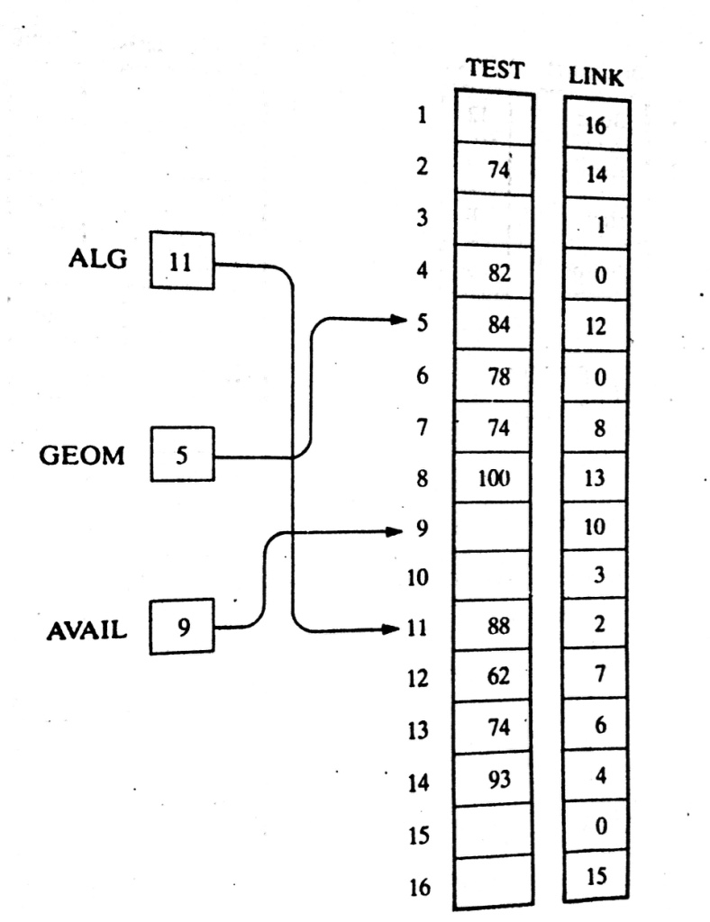
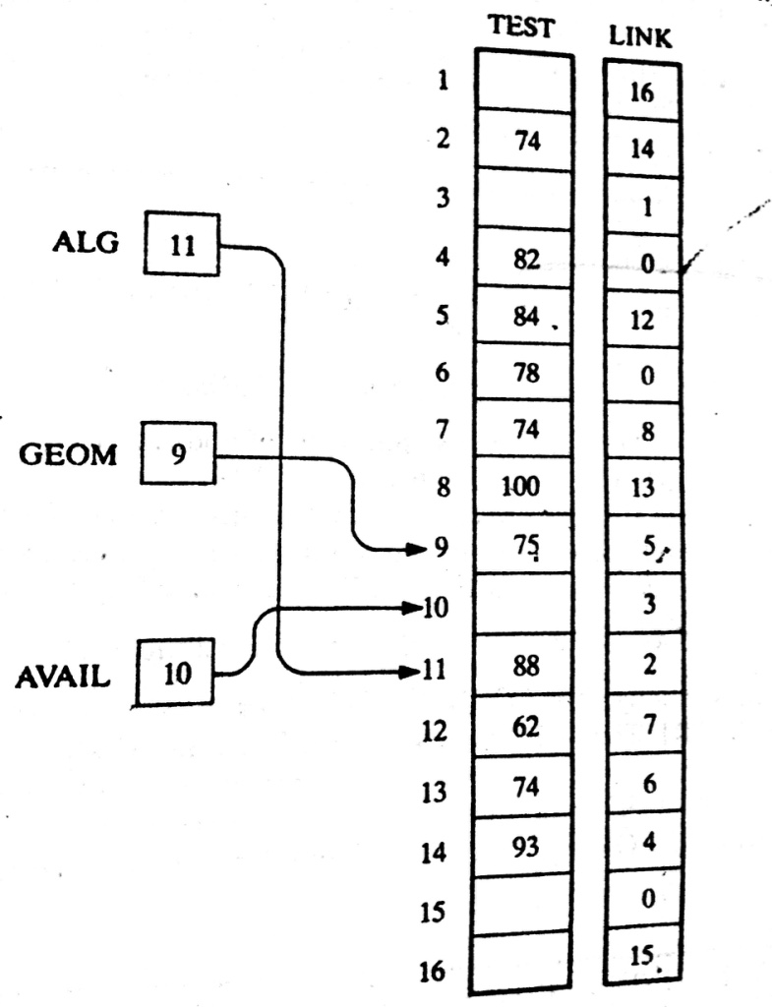
LINKED LISTS: Inserting at the Beginning ….Exmp

Slide 5
LINKED LISTS: Inserting after a given node
INSLOC (INFO, LINK, START, AVAIL, LOC, ITEM)
[OVERFLOW?] If AVAIL=NULL, then Write: OVERFLOW, and Exit.
[Remove first node from AVAIL list.]
Set NEW:=AVAIL and AVAIL:=LINK[AVAIL]
Set INFO[NEW]:=ITEM.[Copies new data into new node.]
If LOC=NULL, then [Insert as first node.]
  Set LINK[NEW]:=START and START:=NEW.
  Else: [Insert after node with location LOC.]
  Set LINK[NEW]:=LINK[LOC] and LINK[LOC]:=NEW.
  [END if If structure.]
Exit.

Slide 6
LINKED LISTS: Inserting into a Sorted Linked List
Given Element
ITEM
ITEM must be inserted between nodes A and B so that
INFO[A] < ITEM <= INFO[B]
Thus,
Firstly we should write an Algorithm to find the location, LOC, where is suitable to insert the ITEM in the sorted linked list.
Secondly, we have to write the algorithm to insert to the found Location.

Slide 7
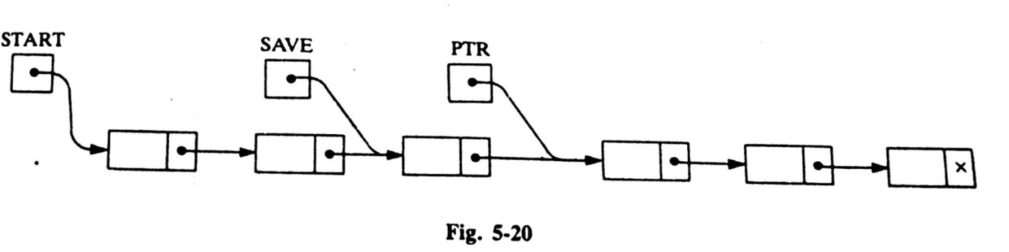
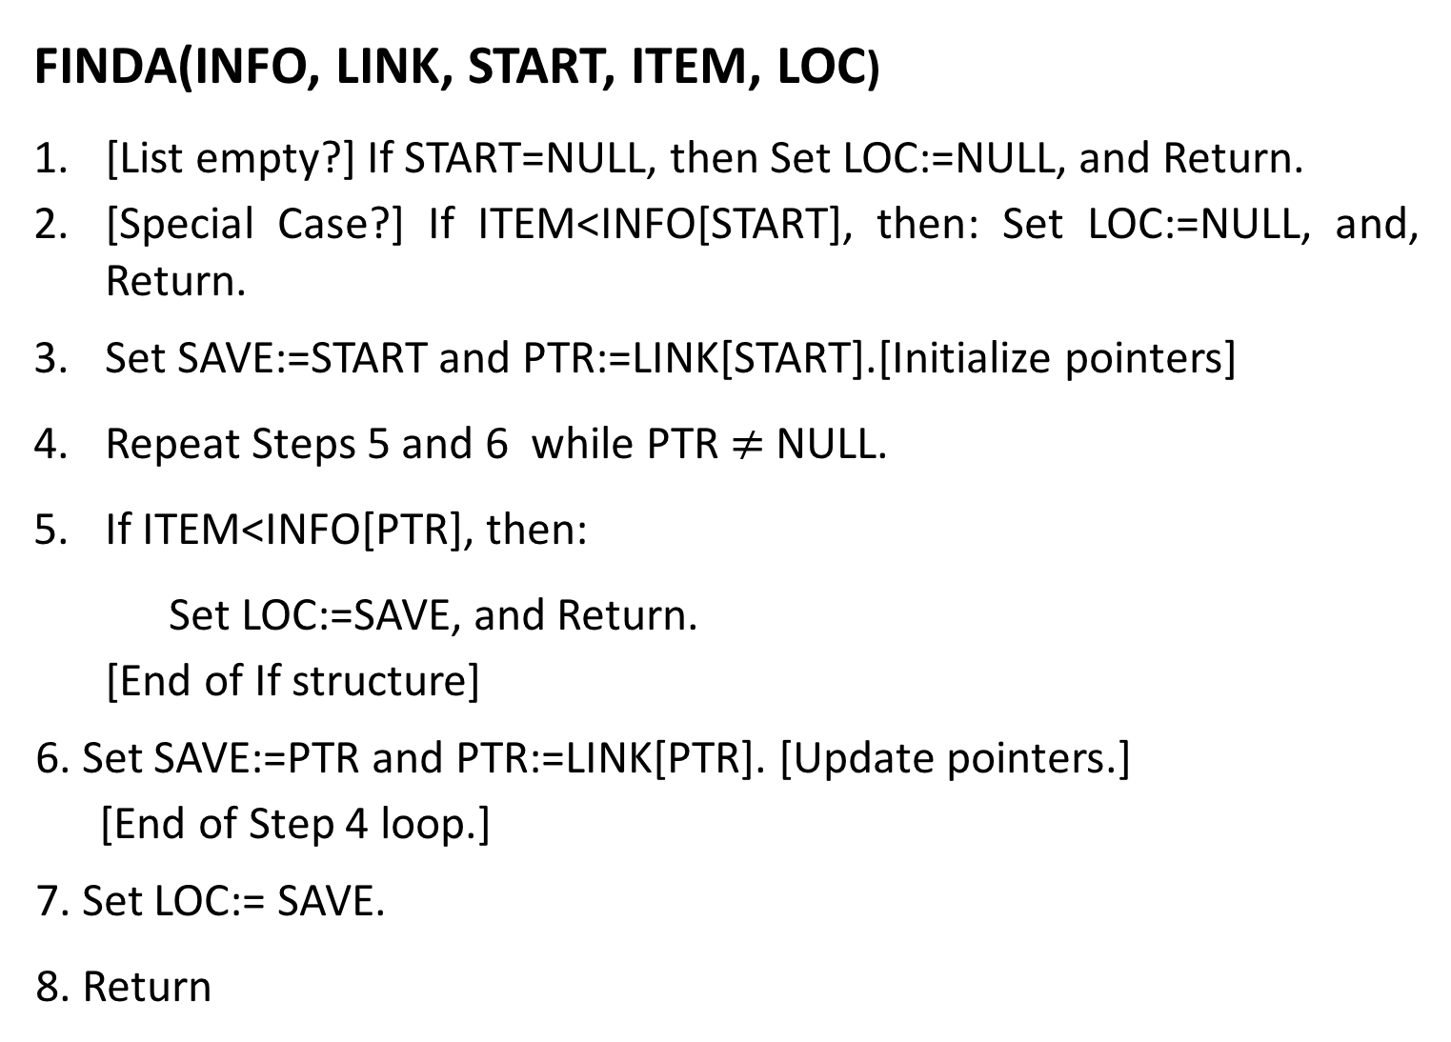
LINKED LISTS: Find LOC in a Sorted Linked List
FINDA(INFO, LINK, START, ITEM, LOC)
[List empty?] If START=NULL, then Set LOC:=NULL, and Return.
[Special Case?] If ITEM<INFO[START], then: Set LOC:=NULL, and, Return.
Set SAVE:=START and PTR:=LINK[START].[Initialize pointers]
Repeat Steps 5 and 6 while PTR$≠$ NULL.
If ITEM<INFO[PTR], then:
  Set LOC:=SAVE, and Return.
  [End of If structure]
  6. Set SAVE:=PTR and PTR:=LINK[PTR]. [Update pointers.]
  [End of Step 4 loop.]
  7. Set LOC:= SAVE.
  8. Return

Slide 8
LINKED LISTS: Insert ITEM into a Sorted Linked List
INSSRT(INFO, LINK, START, AVAIL, ITEM)
[Use FINDA(INFO, LINK, START, ITEM, LOC) to find the location of the proceeding ITEM]
Use INSLOC (INFO, LINK, START, AVAIL, LOC, ITEM) to insert ITEM after the node with location LOC.]
Exit.

Slide 9
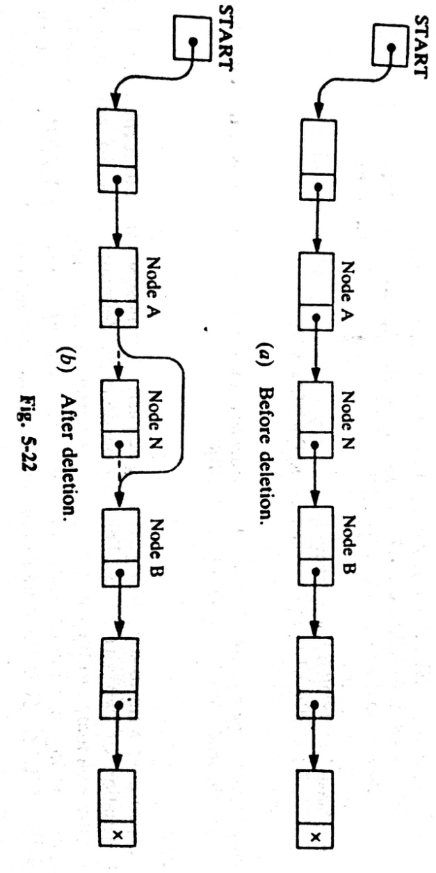
LINKED LISTS: Deletion from a Linked List
Let LIST be a linked list with a node N between nodes A and B.
Here we don’t care about the future of the deleted nodes of the linked list

Slide 10
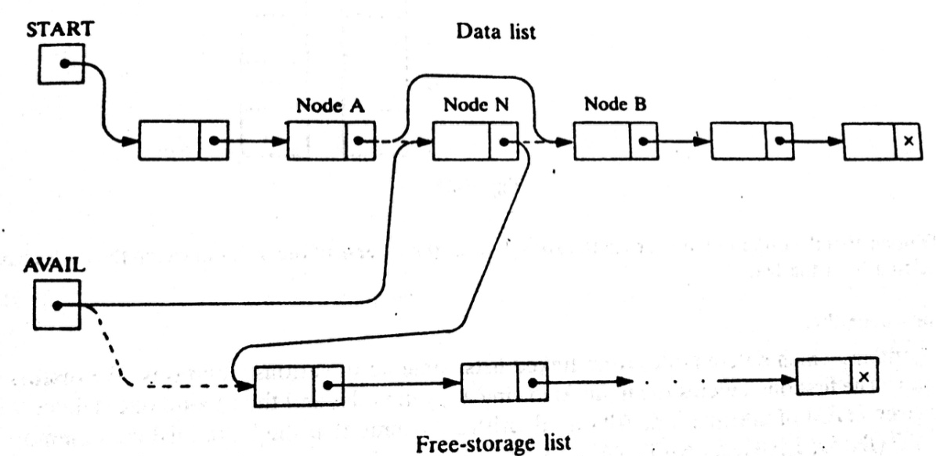
LINKED LISTS: Deletion from a Linked List
More Exact procedure:
Three pointer fields are changed:
The nextpointer field of node A now points to node B.
The nextpointer field of N now points to the original first node in the free pool.
AVAIL now points to the deleted node N.

Slide 11
LINKED LISTS: Deletion from a Linked List
There are also TWO special cases:
If the deleted node N is the first node in the list
  START will point to the node B
If the deleted node N is the last node in the list
  Node A will contain the NULL pointer

Slide 12
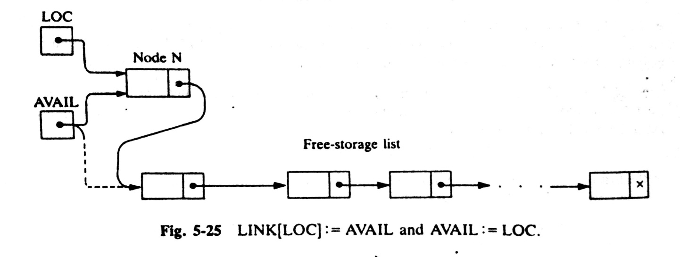
LINKED LISTS: Deletion Algorithms
Algorithms which delete nodes from linked lists come up in various situations:
The first one deletes the node following a given node, and
The second one deletes the node with a given ITEM of information
All algorithms assume that linked list is in memory in the form
LIST(INFO, LINK, START, AVAIL)
All the algorithms will return the memory space of the deleted node N to the beginning of the AVAIL list.

Slide 13
LINKED LISTS:
All algorithms will include the following pair of assignments where
LOC is the location of the deleted node N:
LINK[LOC]:=AVAIL and then AVAIL:=LOC

Slide 14
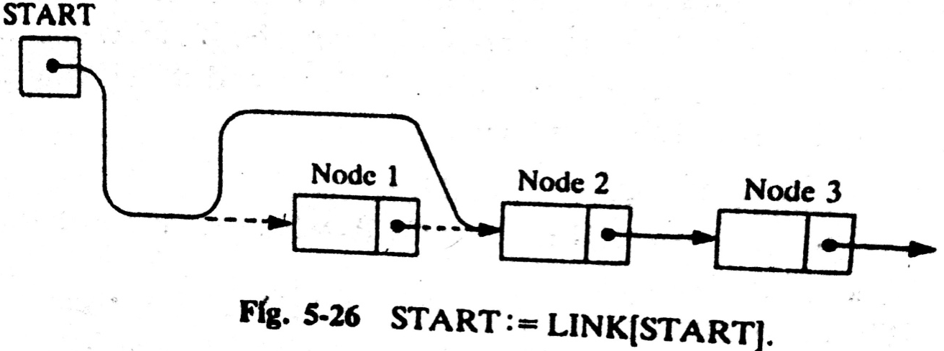
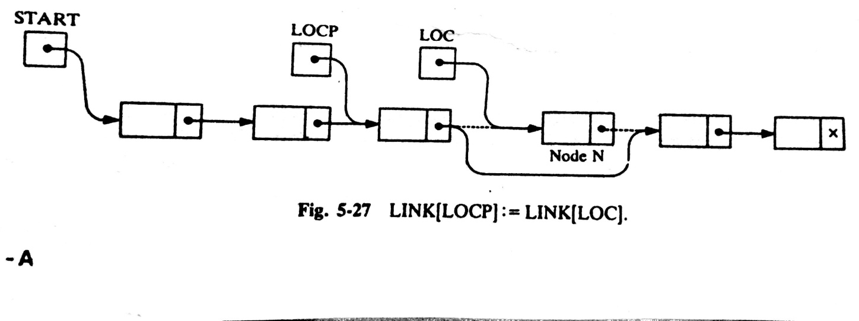
LINKED LISTS: Deleting the node following a Given Node
DEL(INFO, LINK, START, AVAIL, LOC, LOCP)
(it deletes the node N with location LOC, LOCP is the location of the node which precedes N)
Step 1. If LOCP=NULL, then:
Set START:=LINK[START]. [Delete first node.]
Else:
Set LINK[LOCP]:=LINK[LOC]. [Deletes node N.]
[End of If structure]
Step 2. [Return deleted node to the AVAIL list.]
Set LINK[LOC]:=AVAIL and AVAIL:=LOC.
Step 3. Exit.

Slide 15
Thank you……

